Slide 1

Robot Obstacle avoidance with reinforcement learning
Group Members:
Alexandre Dietrich
Ankur Tyagi
Haitham Alamri
Rodolfo Vasconcelos
Intelligent Systems and Reinforcement Learning

Slide 2
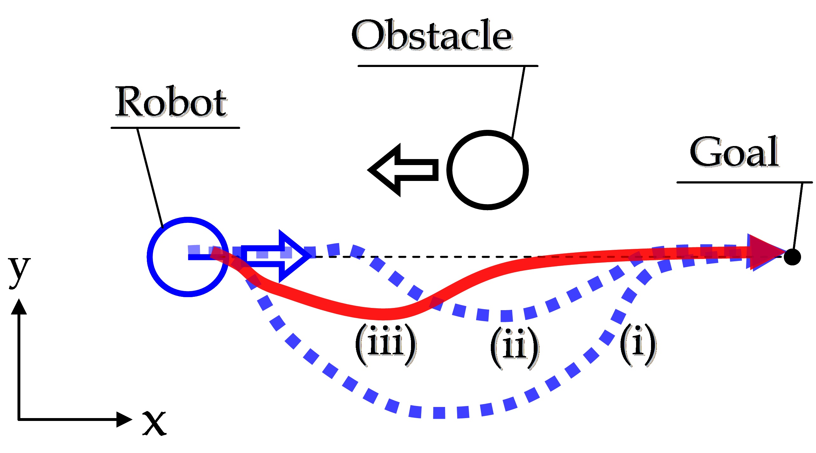
Problem Statement
Find the optimal path for robot to reach an end point (goal state) while avoiding randomly generated obstacles in a 2D space

Slide 3
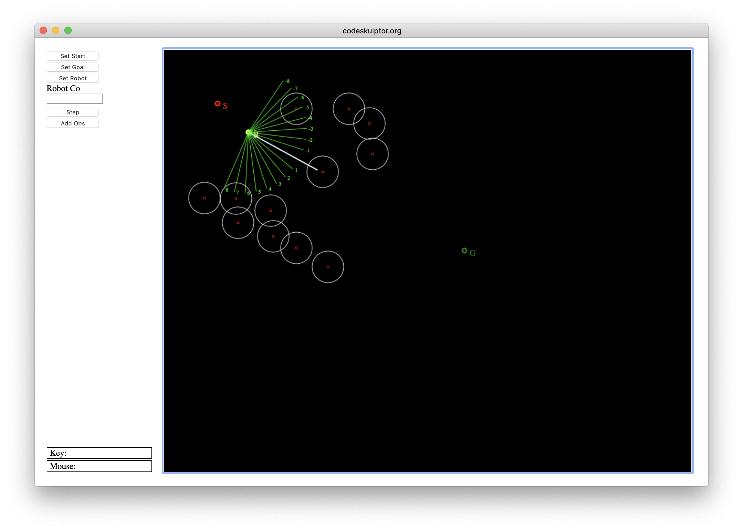
Environment
Environment simulation using python 3 for the project
Simulation Steps:
Choose the starting coordinates of the robot
Choose the target coordinates
Define static obstacles – generated randomly for each episode
Define number of sensors on the robot
Navigate the path using the step and avoid any incoming obstacles while navigating towards the target state.
Objectives:
Identify and optimize the algorithm to avoid the obstacle and reach the destination in least amount of steps
Compare the efficiency of algorithms against each other.
*sample screen shot

Slide 4
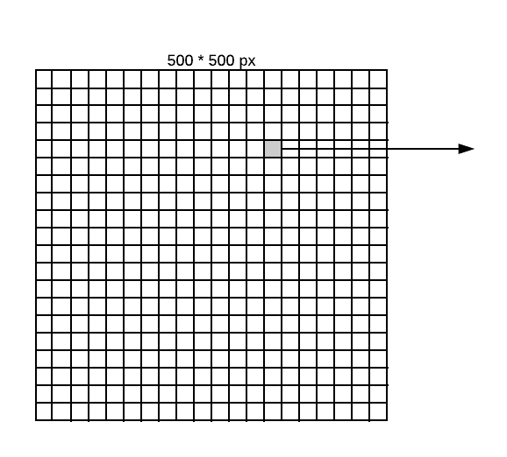
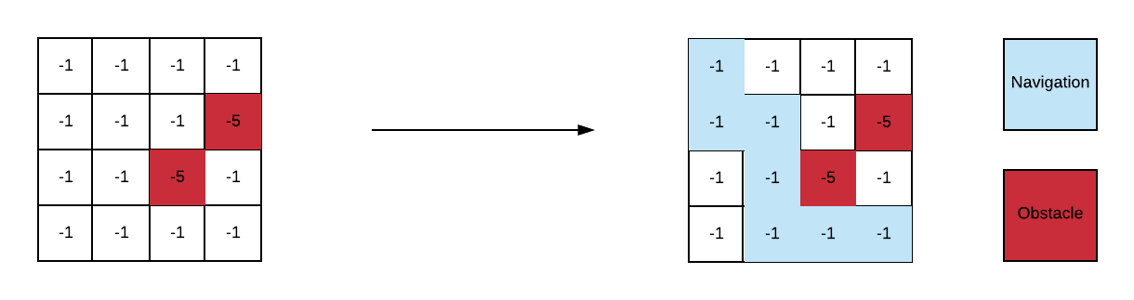
Solution Approach
Set the Canvas size to be 500*500 pixels Grid of 40*40 with each grid of 12.5 pixels Starting point : top corner(10,10) End point : bottom right corner (450, 450) Actions(s): Up, Down, Right and left | States: all possible states within a 4 x 4 grid with 0, 1 or 2 obstacles T : probability of s0 if take action a in state s = 1 (No uncertainty) Reward function: -1 without obstacle -5 when there is an obstacle
One grid - matrix with 2 possible obstacle

Slide 5
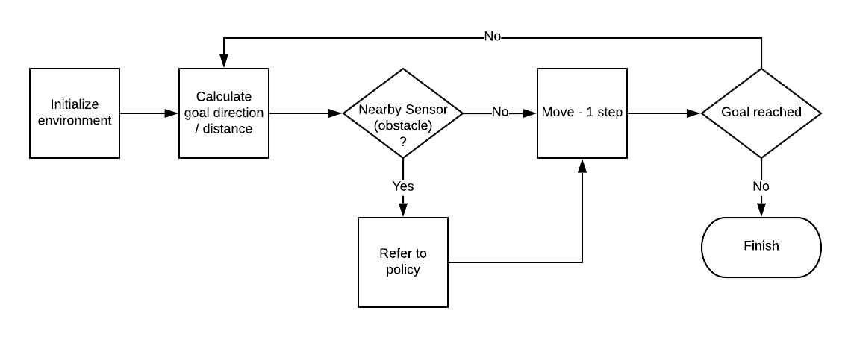
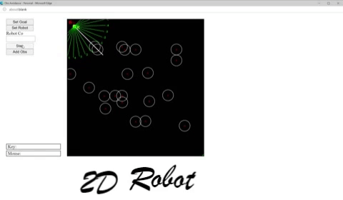
algorithm – 1 (static policy) : Bayesian + static
Execution Steps:
Monte-carlo method to simulate 1000’s of episodes and value iteration Find optimal q-value function for every state and action using the smaller grid to define the master policy | Generated master policy is a dictionary of states and actions Use the optimal policy to playing stage and then run through the agent from the starting point to the goal simulation.

Slide 6
algorithm – 2 (Dynamic policy) - Bayesian
Dynamic start point for the robot Dynamic goal (end-point) for the robot Dynamic obstacle creation (obstacle generated randomly) | In start of every episode robot begins without a policy Robot using the dynamic policy If a policy is not available for that state, a new policy is created using the same Monte Carlo method
Find the optimal path for robot to reach an end point (goal state) while avoiding randomly generated obstacles in a 2D space

Slide 7
algorithm – 3 (HyBrid - Bayesian and Dynamic policy)
500*500 pixels Starting point : top corner(10,10) End point : bottom right corner (450, 450) Actions(s): Up, Down, Right and left States: all possible states within a 4 x 4 grid with 0, 1 or 2 obstacles | T(s'|s; a): probability of s0 if take action a in state s = 1 (No uncertainty) Reward(s; a; s0): -1 without obsctacle, -5 when there is an obstacle Discount factor = 0.6
Find the optimal path for robot to reach an end point (goal state) while avoiding randomly generated obstacles in a 2D space

Slide 8
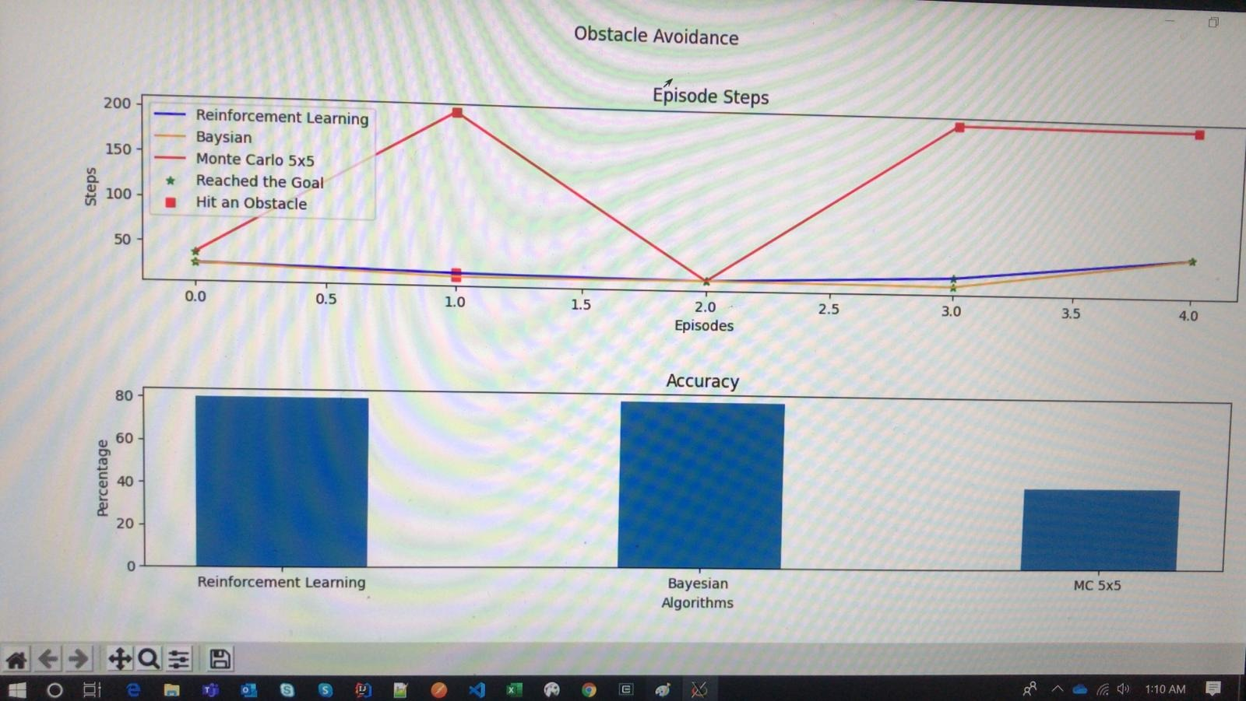
Algorithm Comparisons

Slide 9
Conclusion – Lesson Learnt and future work
Lesson Learnt
1. How to assemble a 360
Possible extensions of the work include :
Use deep learning – q network to further increases the accuracy / calculation for the program.

